Slide 1
Value-Added Report Interpretation and FAQs
Minnesota Report Example
Notes:
This presentation goes over what the color coded reports look like and addresses several frequently asked questions.
Note that the specifics of explanations (especially around testing periods and grade levels) will vary by project.

Slide 2
Sample Report Review

Slide 3
Page 1
Reporting Period and Context
Table of Contents
Color Coding Explanation
Notes:
This is the first page of a typical VARC Value-Added Report.
The number of pages in the report may vary based on the grade configuration or the school.

Slide 4
Page 2
School-Level Value-Added Estimates
Grade-Level Value-Added Estimates

Slide 5
Page 2 Top School-Level Value-Added
Past Academic Year
Up-To-3-Year Average
Past Academic Year 2010-2011
Up-To-3-Year Average
NUMBER OF
STUDENTS
(WEIGHTED)
VALUE-ADDED ESTIMATES
NUMBER OF
STUDENTS
(WEIGHTED)
VALUE-ADDED ESTIMATES
1-5 Scale
1-5 Scale
1
2
3
4
5
1
2
3
4
5
Level of Analysis
School-Level Value-Added
Subject
2.5
2.5
READING
182.9
559.4
MATH
182.9
1.6
559.4
1.7
Number of students included in the analysis
Value-Added Estimate
Point Estimate (number in color-coded bubble)
95% Confidence Interval (black line)
Notes:
These are school-level Value-Added estimates.
Based on the performance of all grade-levels at the school, we can make an estimate of the school’s Value-Added as a whole.
Note that there is some statistical horsepower going on behind the scenes here above and beyond simple weighted averages.
More notably, the process called “statistical shrinkage” is employed here.

Slide 6
Page 2 Bottom Grade-Level Value-Added
FAQ 1:
Which school year is this?
Past Academic Year 2010-2011
Up-To-3-Year Average
NUMBER OF
STUDENTS
(WEIGHTED)
VALUE-ADDED ESTIMATES
NUMBER OF
STUDENTS
(WEIGHTED)
VALUE-ADDED ESTIMATES
1
2
3
4
5
1
2
3
4
5
READING
Grade-Level Value-Added
Grade 4
58.7
2.1
171.9
1.9
Grade 5
68.3
3.3
187.5
4.3
Grade 6
55.9
2.6
200.1
2.1
MATH
Grade-Level Value-Added
Grade 4
58.7
1.1
171.9
0.7
Grade 5
68.3
1.6
187.5
1.8
Grade 6
55.9
3.8
200.1
4.1
Notes:
These are grade-level team Value-Added results.
Value-Added is measuring the effectiveness of these grade-level teams by comparing the actual longitudinal academic growth of these students to observationally similar peers from across the state.

Slide 7
Value-Added on the MCA
Grade 3
Summer
Grade 4
Summer
Grade 5
Summer
Grade 6
April
April
April
April
4th Grade
Value-Added
5th Grade
Value-Added
6th Grade
Value-Added
4th grade example:
“Starting knowledge” is the April 2010 3rd grade test.
“Ending knowledge” is the April 2011 4th grade test.
This aligns to growth in the 2010-2011 4th grade school year.
Why don’t we have 3rd grade Value-Added in Minnesota?
Notes:
Grade-level Value-Added estimates can be taken at face value for the grade period labels.
The “4th grade” Value-Added estimates are aligned to the growth during the 4th grade school year.
(No need to subtract or add a year like may be necessary when trying to interpret attainment results)
There is no 3rd grade Value-Added in Minnesota because there is no April 2ndgrade test to determine how much students grew in the 3rd grade year.

Slide 8
Page 2 Bottom Grade-Level Value-Added
FAQ 2:
How do I interpret the
“Up-To-3-Year Average”?
Past Academic Year 2010-2011
Up-To-3-Year Average
NUMBER OF
STUDENTS
(WEIGHTED)
VALUE-ADDED ESTIMATES
NUMBER OF
STUDENTS
(WEIGHTED)
VALUE-ADDED ESTIMATES
1
2
3
4
5
1
2
3
4
5
READING
Grade-Level Value-Added
Grade 3
58.7
2.1
171.9
1.9
Grade 4
68.3
3.3
187.5
4.3
Grade 5
55.9
2.6
200.1
2.1
MATH
Grade-Level Value-Added
Grade 3
58.7
1.1
171.9
0.7
Grade 4
68.3
1.6
187.5
1.8
Grade 5
55.9
3.8
200.1
4.1
Notes:
Averages keep track of a teaching team’s performance over multiple groups of students.
This is a way for the statistical model to have more data to determine the true effectiveness of a grade-level team at a school. For example, there are only 58.7 students for the past academic year in 3rd grade reading at this school. By looking at three cohorts of 3rd grade reading students at this school, we can more accurately determine the true effect of the teaching team with 171.9 students.

Slide 9
What Does “Up-To-3-Year Average” Mean for the 4th Grade?
Does not follow individual students for 3 years
Represents the 4th grade teaching team over three cohorts of students
NOT Jimmy as he goes through three consecutive school years
3rd grade to 4th grade
4th grade to 5th grade
5th grade to 6th grade
4th grade team with
2008-09 cohort (3rd grade to 4th grade)
2009-10 cohort (3rd grade to 4th grade)
2010-11 cohort (3rd grade to 4th grade)
Keep teacher mobility in mind
Notes:
The “Up-To-3-Year Average” represents the 4th grade teaching team over three cohorts of students.
It is longitudinal growth of students, but only for a single school year (pre-test to post-test).
Keep in mind that the 4th grade teaching team from one year may be different than the teaching team from previous years. Keep this in mind when interpreting results.

Slide 10
What Does “Up-To-3-Year Average” Mean?
Past Academic Year 2010-2011
Up-To-3-Year Average
NUMBER OF
STUDENTS
(WEIGHTED)
VALUE-ADDED ESTIMATES
NUMBER OF
STUDENTS
(WEIGHTED)
VALUE-ADDED ESTIMATES
1
2
3
4
5
1
2
3
4
5
READING
Grade-Level Value-Added
Grade 4
20
2010-2011 4th Graders
60
08-09 4th Gr.
09-10 4th Gr.
10-11 4th Gr.
Grade 5
20
2010-2011 5th Graders
60
08-09 5th Gr.
09-10 5th Gr.
10-11 5th Gr.
Grade 6
20
2010-2011 6th Graders
60
08-09 6th Gr.
09-10 6th Gr.
10-11 6th Gr.
The “Past Academic Year” represents longitudinal growth over a single school year.
The “Up-To-3-Year Average” represents average longitudinal growth of three different groups of students at each grade level.

Slide 11
What Does “Up-To-3-Year Average” Mean?
Past Academic Year 2010-2011
Up-To-3-Year Average
NUMBER OF
STUDENTS
(WEIGHTED)
VALUE-ADDED ESTIMATES
NUMBER OF
STUDENTS
(WEIGHTED)
VALUE-ADDED ESTIMATES
1
2
3
4
5
1
2
3
4
5
READING
Grade-Level Value-Added
Grade 4
48.5
3.4
146.0
3.5
Grade 5
44.5
4.1
141.1
0.9
Grade 6
46.0
4.4
147.8
2.8
Which grade-level teaching team…
Was most effective in the 2010-2011 school year?
Was most effective over the past three school years?
Was more effective in 2010-2011 than in the past?
Notes:
The 6th grade teaching team was most effective in the most recent school year. The 4.4 point estimate is the highest of the grades.
The 4th grade teaching team was most effective over the past three school years. The 3.5 point estimate is the highest of the grades.
The 5th grade teaching team improved their teaching in this past academic year. Over the 3-Year Average, their Value-Added was a red 0.9, but this last year it was up to a green 4.1. This is a big improvement in this teaching team’s effectiveness. Something they tried last year worked a lot better with their students than in previous school years.

Slide 12
Page 2 Bottom Grade-Level Value-Added
Past Academic Year 2010-2011
Up-To-3-Year Average
NUMBER OF
STUDENTS
(WEIGHTED)
VALUE-ADDED ESTIMATES
NUMBER OF
STUDENTS
(WEIGHTED)
VALUE-ADDED ESTIMATES
1
2
3
4
5
1
2
3
4
5
READING
Grade-Level Value-Added
Grade 4
58.7
2.1
171.9
1.9
FAQ 3:
Does this show student growth to go from red to yellow to green over time?
Grade 5
68.3
3.3
187.5
4.3
Grade 6
55.9
2.6
200.1
2.1
MATH
Grade-Level Value-Added
Grade 4
58.7
1.1
171.9
0.7
Grade 5
68.3
1.6
187.5
1.8
Grade 6
55.9
3.8
200.1
4.1
Notes:
This question shows a general misunderstanding of what Value-Added is measuring.
Beginner viewers may believe that they are looking at achievement data rather than growth data.
If this was achievement data, indeed our students look like they’re improving their levels as they go through this school. (But even this reasoning is flawed since these would represent three different cohorts of students)
In reality, this scenario shows:
A 4th grade team making far below average growth with their students
A 5th grade team making below average growth with their students
A 6th grade team making above average growth with their students

Slide 13
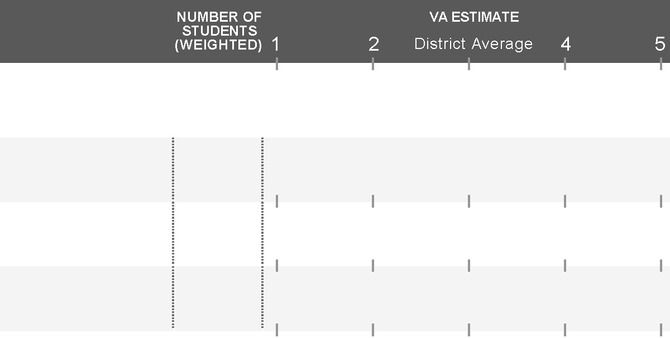
Value-Added, Not Achievement
In your groups:
Describe this school’s math performance
Describe this school’s reading performance
3
MATH
Grade 4
61
3.8
Grade 5
63
3.9
Grade 6
60
3.9
3
READING
Grade 4
61
4.8
Grade 5
63
3.0
Grade 6
60
1.1
Notes:
In Math:
All grade levels are making above average growth with their students
In Reading:
The 4th grade team is making far above average growth with their students
The 5th grade team is making average growth with their students
The 6th grade team is making far below average growth with their students

Slide 14
Page 2 Bottom Grade-Level Value-Added
FAQ 4:
Why are there non-integer numbers of students?
Past Academic Year 2010-2011
Up-To-3-Year Average
NUMBER OF
STUDENTS
(WEIGHTED)
VALUE-ADDED ESTIMATES
NUMBER OF
STUDENTS
(WEIGHTED)
VALUE-ADDED ESTIMATES
1
2
3
4
5
1
2
3
4
5
READING
Grade-Level Value-Added
Grade 4
58.7
2.1
171.9
1.9
Grade 5
68.3
3.3
187.5
4.3
Grade 6
55.9
2.6
200.1
2.1
MATH
Grade-Level Value-Added
Grade 4
58.7
1.1
171.9
0.7
Grade 5
68.3
1.6
187.5
1.8
Grade 6
55.9
3.8
200.1
4.1
Notes:
Value-Added is based on a dosage model where partial credit for growth can be given to schools that served students for less than a full school year.

Slide 15
Mobile Students
If a student is enrolled in more than one school between the beginning of the school year and the spring MCA administration, each school gets credit for a portion of the student’s growth.
60% Attributed to A
40% Attributed to B
School A
School B
Grade 4
Beginning of School Year
April MCA
Notes:
Dosage can span more than two schools. The breakdown between schools is determined by enrolled days.

Slide 16
Page 3
School-Level Value-Added and Achievement
Scatter Plot Interpretation

Slide 17
Page 3 Scatter Plots

Slide 18
How to Read the Scatter Plots
100
These scatter plots are a way to represent Achievement and
Value-Added together
Achievement
80
60
Percent Prof/Adv (2010)
Value-Added
40
20
0
1
2
3
4
5
Value-Added (2010-2011)
Notes:
The black lines represent average achievement and average Value-Added
The gray bars represent one standard deviation above and below that average

Slide 19
How to Read the Scatter Plots
A. Students know a lot and are growing faster than predicted
100
C
A
B. Students are behind, but are growing faster than predicted
80
E
C. Students know a lot, but are growing slower than predicted
60
Percent Prof/Adv (2010)
B
D. Students are behind, and are growing slower than predicted
40
D
E. Students are about average in how much they know and how fast they are growing
20
0
1
2
3
4
5
Schools in your district
Value-Added (2010-2011)
Notes:
The black lines represent average achievement and average Value-Added
The gray bars represent one standard deviation above and below that average

Slide 20
Page 4 (or 4 & 5 for large grade span schools)
Grade-Level Value-Added and Achievement

Slide 21
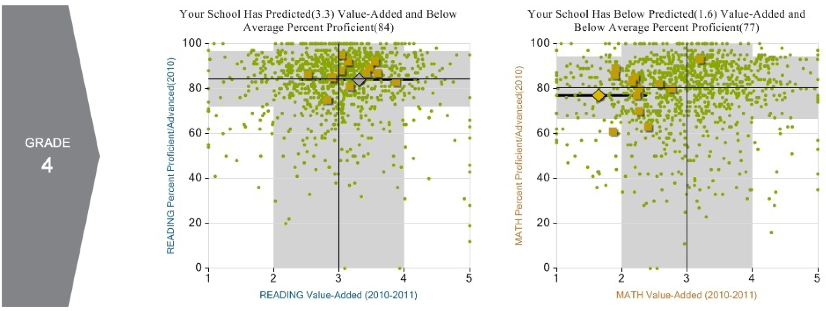
Page 4 Example (Grade 4)

Slide 22
Last Page
1-5
Value-Added Scale
Control Variables in the Model
Notes:
The control variables may change by test and reporting period. Please refer to your actual PDF report for the most up-to-date version of the control variables used in the Value-Added model.

